Slide 1
FINAL PROJECT QUALITY ENGINEER
Alterra Academy

Slide 2
Name : Aurora Fatwari Suryadi
From : Gunadarma University
Major : Information System
Introduction

Slide 3
Table of Content
EXPOSURE DOCUMENTATION,
01
Test Plan Document
Test Scenario / Test Case Document
AUTOMATED TEST,
02
Automated Test Definition
Automated Tools Used
Web UI test explanation
Rest API test explanation
Mobile application test explanation
RESULTS AND REPORT,
03
Bug report Document explanation

Slide 4
Project Milestones
DESIGN TEST
EXECUTE TEST
Create test scenario and test case.
Run the automation test process.
PLAN TEST
IMPLEMENT TEST
EVALUATE TEST
Create a plan test document.
Select and implement features that can be tested for automation
Create a result and bug report.

Slide 5
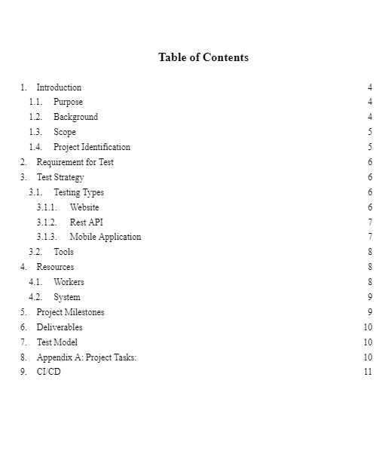
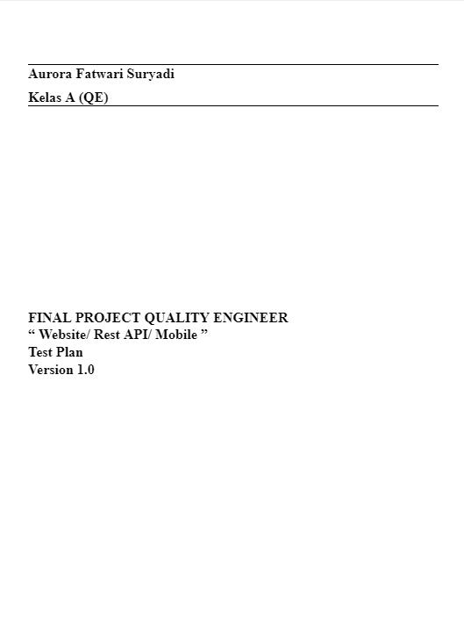
Link Test Plan :
https://bit.ly/3l9KLoi
Test Plan Documentation
What is a
Test Plan Documentation?
Test plan explains how the software created can run according to a predetermined plan. The main focus of this application is to ensure the alignment of information between all these systems.

Slide 6
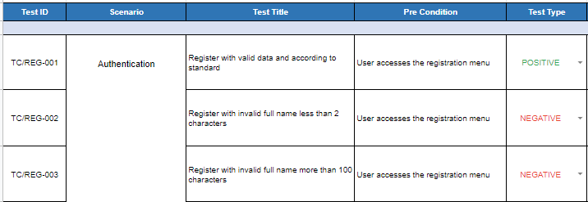
What is a Test Scenario?
Test Scenario gives the idea of what we have to test. It’s like a high-level test case.
Test Scenario and Test Case Document
What is a Test Case?
Test case has a set of pre-conditions, steps, expected result and actual result. Test case are a set of positive and negative of test scenario.
Link Test Scenario / Test Case :
https://bit.ly/3yuTNnB

Slide 7


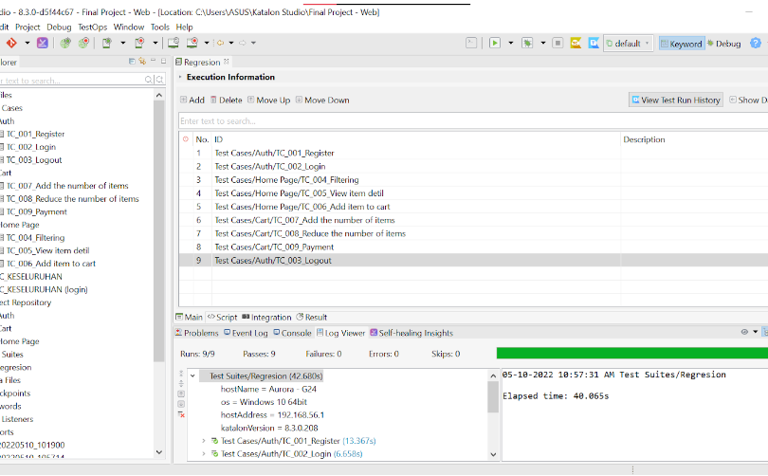
Automated Test
Automation Testing means using an automation tool to execute test
case suite.
Testing Type and Scope :
Web UI
Do the test by paying attention to the function and user interface on the website.
https://qa.alta.id/
Rest API
Ensure the appropriate response code and data.
https://be-qa.alta.id/
Mobile Application
Do the test by paying attention to the function and user interface on the mobile application.
alta-online-shop.apk

Slide 8
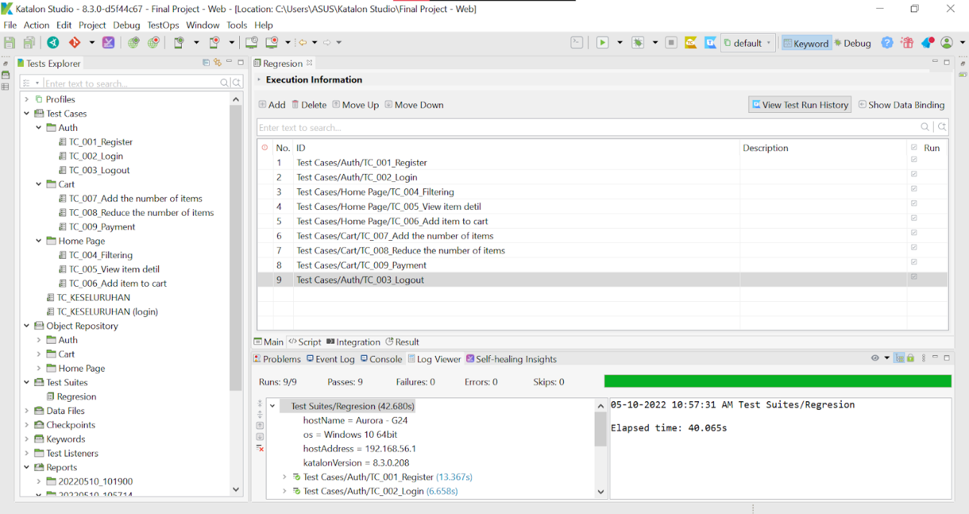
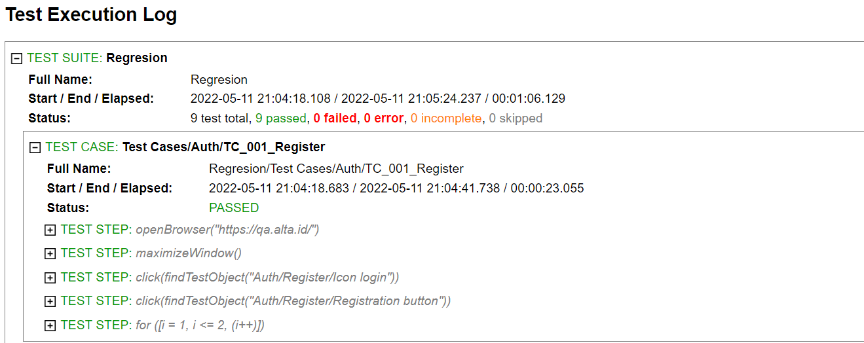
Web UI
Module | Features | Descriptions | User
Authenticaion | Register | Register a new account | √
 | Login | Login into system with a registered account | √
 | Logout | Logout the system | √
Home Page | Searching / Filter | Filter the desired item | √
 | View item | View item details | √
 | Buy item | Add items to shopping list | √
Cart | Add item | Add number of items | √
 | Reduce item | Reduce the number of items | √
 | Remove item | Remove items on shopping list | √
 | Payment | Make payment for the selected item | √
Transactions | View transaction | View transaction item details | √
 | Filtering list by product | Filter items by product category | √
 | Filtering list by price | Filter items by price category | √
 | Filtering list by quantity | Filter items by item quantity category | √
 | Filtering list by sub total | Filter items by sub total of item category | √
 | Select rows option page | Choose an available rows option page | √
 | Paginations | View the next page of item detils | √
https://qa.alta.id/

Slide 9
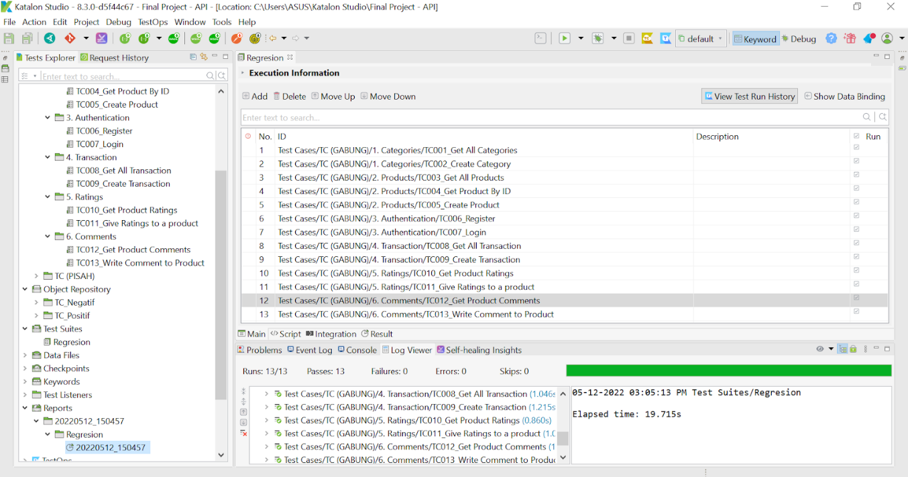
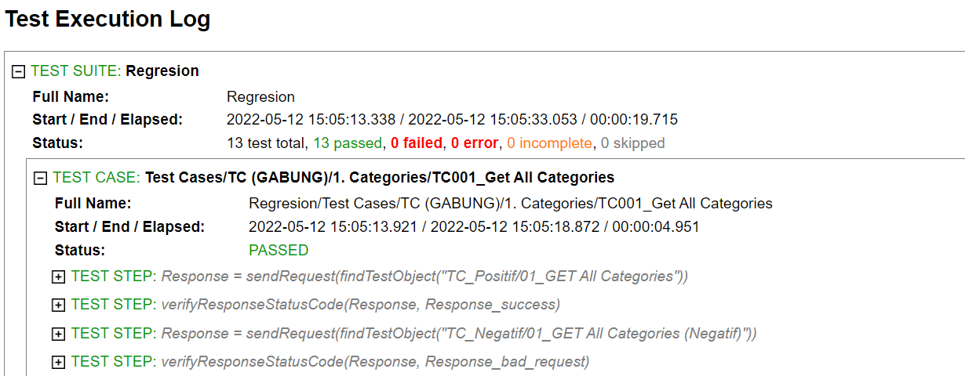
Rest API
Module | Features | Descriptions | User
Categories | Get All Categories | Display data from all categories | √
 | Create Categories | Add new category data | √
Product | Get All Products | Display data of all products | √
 | Get Product By ID | Display data based on the searched id | √
 | Create Product | Add new product data | √
Authentication | Register | Create new registrant data | √
 | Login | Login with valid data dan show the valid token | √
Transactions | Get All Transactions | Display data from all transactions | √
 | Create Transaction | Add new transaction data | √
Ratings | Get Products Ratings | Displaying the rating of a product | √
 | Give Ratings to a Product | Give a rating on a product | √
Comments | Get Products Comments | Displaying comments on a product | √
 | Write Comments to a Product | Write a comment on a product | √
https://be-qa.alta.id/

Slide 10
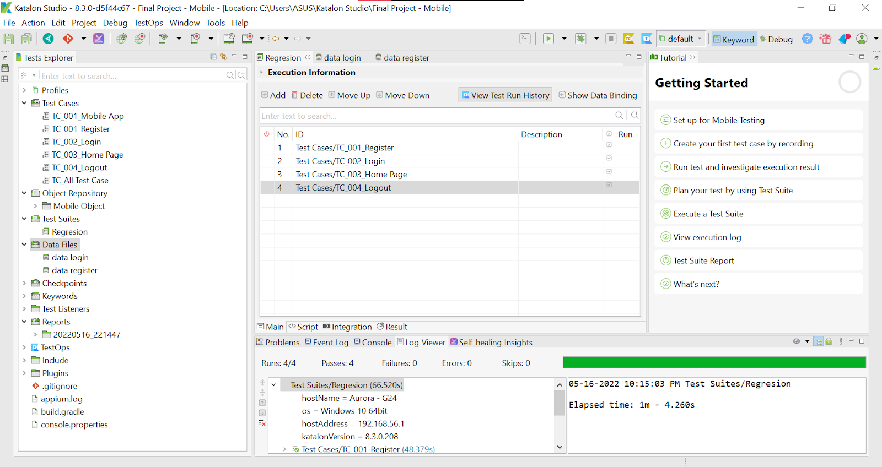
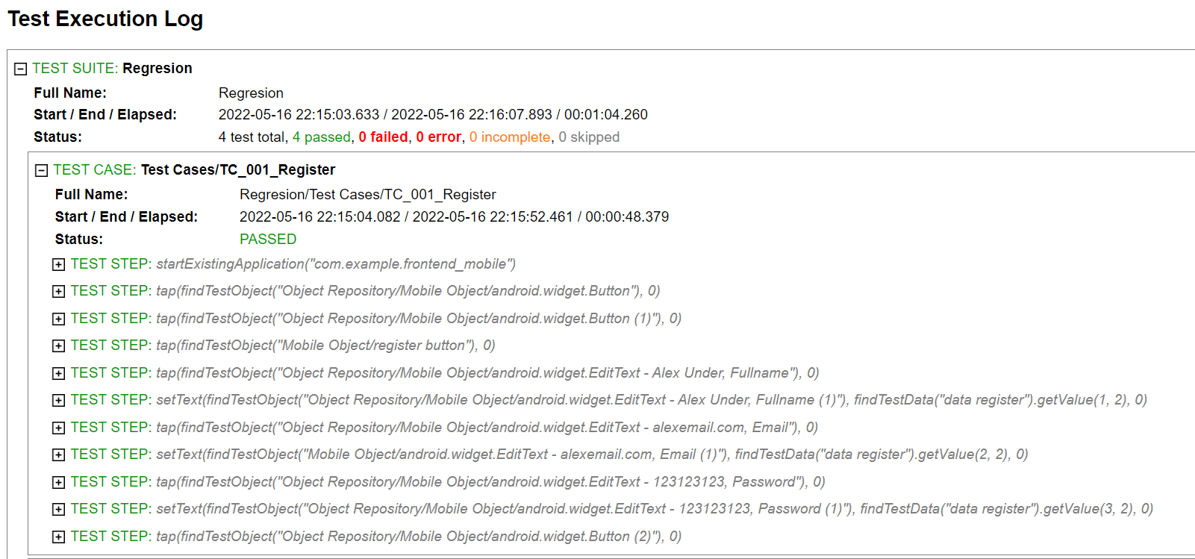
Mobile
Module | Features | Descriptions | User
Authenticaion | Register | Register a new account | √
 | Login | Login into system with a registered account | √
 | Logout | Logout the system | √
Home Page | Buy item | Add items to shopping list | √
Cart | View item | Display a list of purchased items | √
alta-online-shop.apk

Slide 11
Result and Report
Bug Report Document
This document is used to report test results on applications that have been created. The results of the tests that have been carried out will be used to determine the quality of the application.
Bug
Web UI
Rest API
Mobile
Manual test result
Automated test result
Link Bug Report:
https://bit.ly/3wj3c05

Slide 12
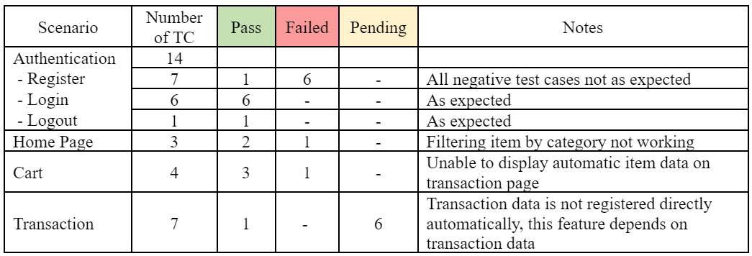
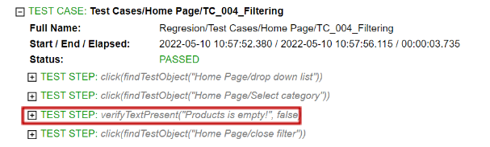
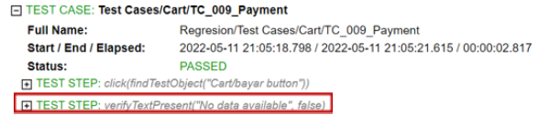
Manual Test
Results and conclusions :
Test result difference on automation testing
(Test 1) There are differences in test results between manual and automatic tests on the payment feature.
manual testing : Unable to display automatic item data on transaction page (FAILED).
automation testing : Successfully to display item data on transaction page (PASS).
(Test 2) There is a change in the test report results on the payment feature.
manual testing : Unable to display automatic item data on transaction page (FAILED).
automation testing : Unable to display automatic item data on transaction page (FAILED).
Does not perform automated testing on the transaction feature because it is unstable.
There are failed results on the filtering feature and unstable on the payment feature. So that if the test automation is re-run, it is likely that the results will be different (there is an error).
Automated Test
Bug Report Web UI
Bug

Slide 13
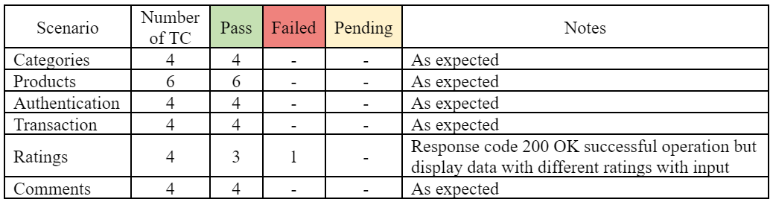
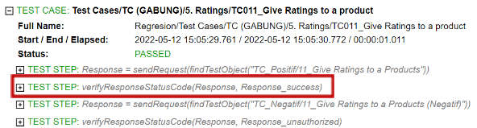
Manual Test
Results and conclusions :
The results between manual testing and test automation produce the same report.
For the feature of give a rating to the product when testing results in a response code of 200 OK, but the data displayed does not match what was inputted (FAILED), even if the test automation is successful (PASS).
The product id is always changing so if the test is re-run it will failed.
Automated Test
Bug Report Rest API
Bug

Slide 14
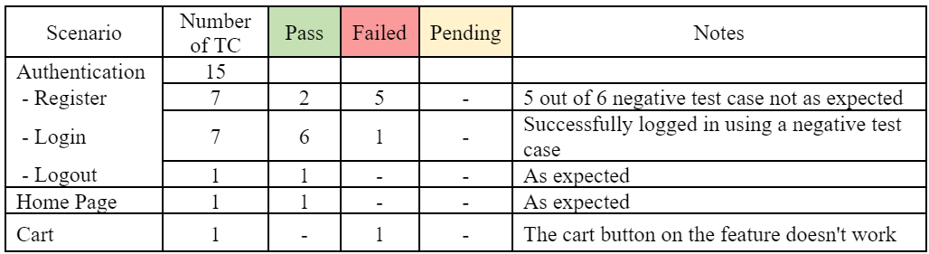

Manual Test
Results and conclusions :
In the login feature there is a bug where you can login with an email and password that contains spaces.
Manual and automation testing has been carried out, but there is still a bug in one of the features so it is skipped.
There is a feature that doesn't work (cart button). so that the feature is not tested for automation.
No object element to verify.
Bug Report Mobile
Automated Test
Bug

Slide 15
THANK YOU
Any Question?

